Slide 1

Electricity Demand In Victoria
Analysis on the effect of weather on electricity consumption.

Slide 2
Core message
Does weather affect electricity demand in Victoria?
Which Geographical areas in Victoria has the highest electricity demand and growth?
Hypothesis:
H1: Increase in temperature above mean will cause an increase in energy consumption.
H2: Decrease in temperature below mean will cause an increase in energy consumption.
Business problems and objectives:
Relationship of electricity demand and temperature, solar exposure and rainfall will help to forecast the electricity demand for electricity retail companies.
Knowing the electricity demand and growth helps electricity retailer to understand where to focus on sales and marketing
Findings:
Temperature above or below mean causes the electricity demand to rise
Higher solar exposure causes reduction in electricity demand

Slide 3
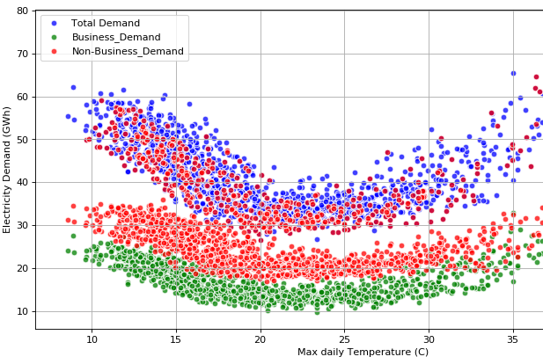
Exploratory Data Analysis: Observing the visual relationship between daily temperature and energy consumption.

Slide 4
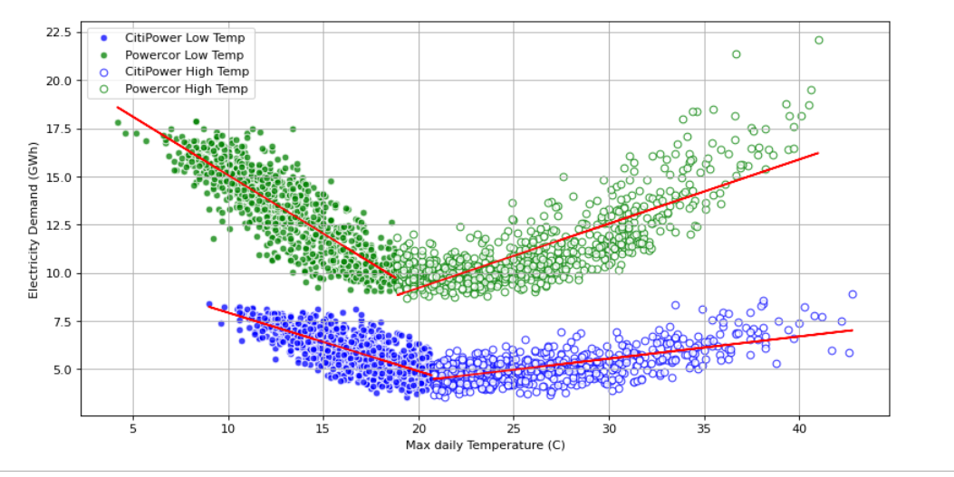
CitiPower and PowerCor electricity demand with temperature

Slide 5
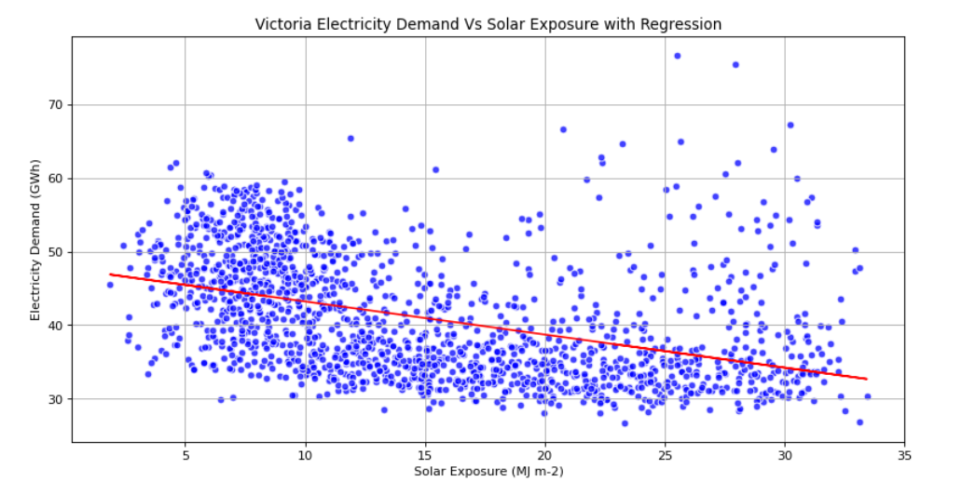
Electricity demand with Solar exposure

Slide 6
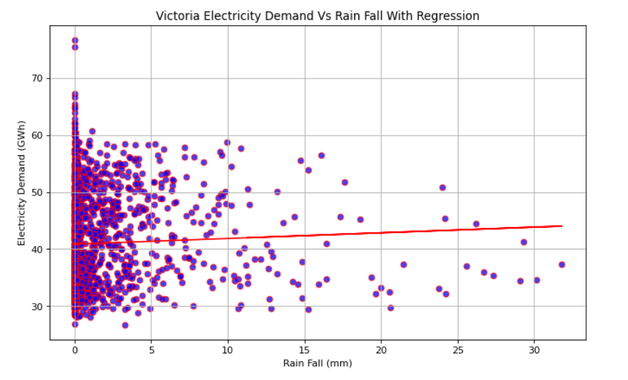
Electricity demand with Rainfall

Slide 7
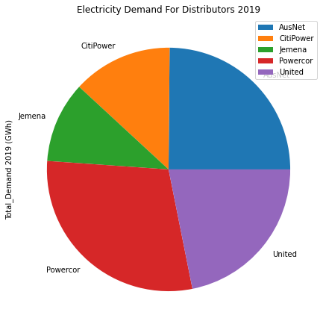
Exploratory Data Analysis: Energy providers in Victoria

Slide 8
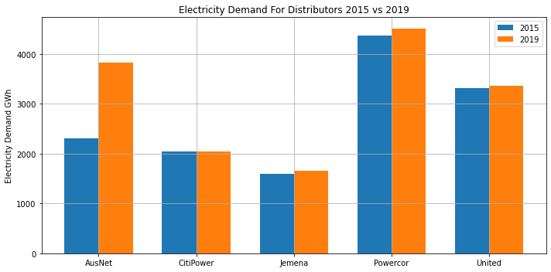
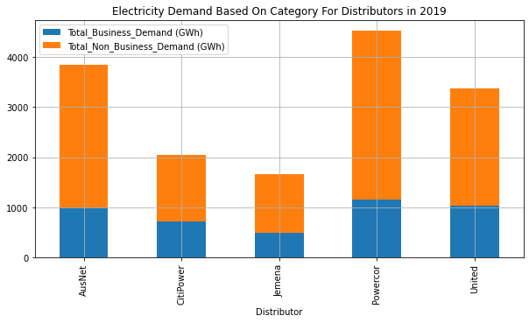
Exploratory Data Analysis: Energy providers in Victoria

Slide 9
Conclusions
Does weather affect electricity demand in Victoria?
When temperature move away from the mean temperature, demand has significant increase
- Use of air conditioning and heating could be possible cause of this.
When solar exposure increases, demand for electricity decreases.
- Residential solar generation could be the cause for this.
Rainfall had no significant affect on electricity demand.
Which Geographical areas in Victoria has the highest electricity demand and growth?
Powercor in western Victoria has the highest electricity demand
Ausnet in eastern Victoria has the highest electricity demand growth

Slide 10
Discussion?

